Slide 1



Education
September 2020

Slide 2

Schools are overwhelmed by the vast volume of paperwork that comes in every year, whether it’s student transcripts, transfer requests, admission applications or student exams.
Rising tide of paperwork has put an increasing strain on productivity and cost efficiency.
Long grading process delays the time for teaching.
Student records include sensitive information that need to be secured.
Manually entering transcript data is extremely time consuming.
School staff need to keep up with their fast-paced working environment.
Huge volume of paperwork leads to misplacing/losing important documents.
Large workload leads to delays and communication errors.

Slide 3
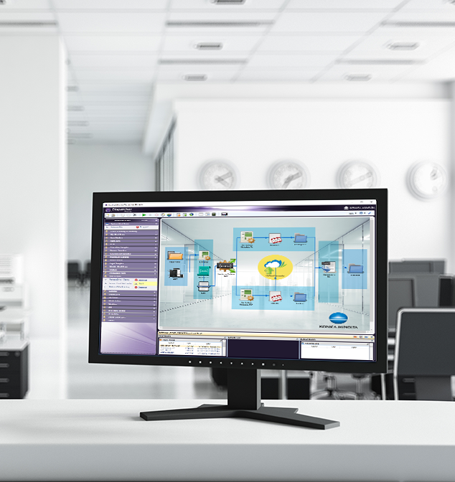

Dispatcher Phoenix is…
  Award Winning!
Konica Minolta-developed, award-winning automation solution designed to:
Optimize business processes
Reduce costs
Increase productivity
Drive collaboration
Promote growth and innovation
Received the 2021 ‘ASTORS’ Homeland Security Platinum Award for Best Imaging Technology
Selected as BLI’s 2022 Pick for Outstanding Workflow Automation Platform

Slide 4
Drive Change with Dispatcher Phoenix’s Education Solution
With Konica Minolta’s Dispatcher Phoenix, hospitals, clinics, and other healthcare organizations can:
Simplify their workflows for student records, applications, transcripts, and other educational documents and increase efficiencies.
Minimize the need for human intervention in their redundant processes.
Maximize productivity & reduce administrative costs.
Provide greater process visibility to identify potential bottlenecks.
Capture
files automatically
Process
and route jobs with ease
Distribute
in a single step
Dispatcher Phoenix makes creating workflows easy!

Slide 5
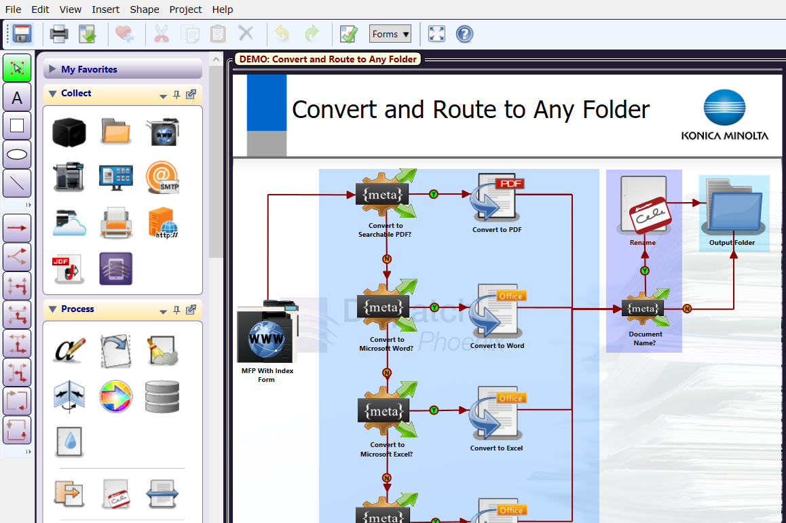
Easily Create and Manage Workflows
  Award Winning!
Selected as BLI’s 2020 Pick for Outstanding Workflow Automation Platform
  Dispatcher Phoenix’s intuitive Workflow Builder Tool is unique in the market.
  Allows for advanced, customized workflows to be easily created to suit the specific needs of the hospital.
  Easy-to-use features include:
    Graphical icons
    Drag-and-drop functionality
    Drawing tools
    Easy to follow validation messages

Slide 6
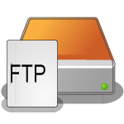



Optimize Workflows with LiveFlo
Displays files being processed through running workflows.
Makes it easy to identify bottlenecks.
Ensure that inputs, processes and outputs are optimized.

Slide 7
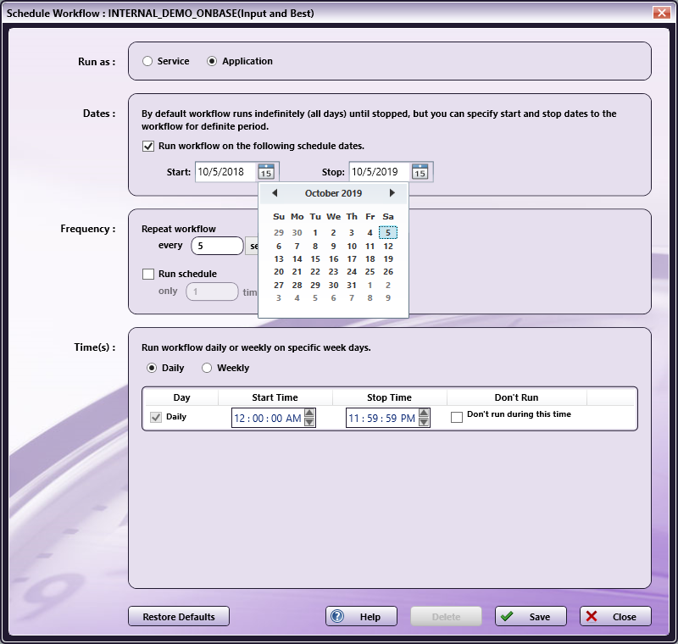
Schedule Workflows to run when you need them!
  Award Winning!
Specify a day of the week or time of the day along with a frequency to ensure workflows complete your automation needs when it’s most convenient for the team.
Save valuable time and resources by scheduling high-volume, heavy processing workflows after working hours.
Schedule workflows to run as a service continually while the PC is on.

Slide 8

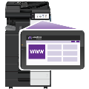


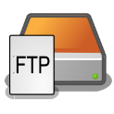




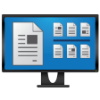

Advanced Capture
  Automatically collect documents from a variety of ways for advanced processing, routing, printing, or storing, including:
  MFP
  Watched Folder
  Email Inbox
  Mobile Device
  Workstation
  Web Capture
  FTP Server
  Dropbox Folder
  LPR Print Queue
  Etc.

Slide 9

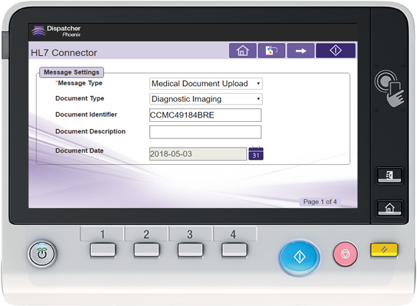
Automated Document Processes
Dispatcher Phoenix supports a variety of document processing tasks from the most simple to more complex including:
Annotation
Watermarking
Rename Files
PDF & Microsoft Office
Conversion
Barcode Processing
Bubble Grader
Intelligent Redaction
Cloud Connectors
Zonal Extraction
Indexing
Many more…

Slide 10

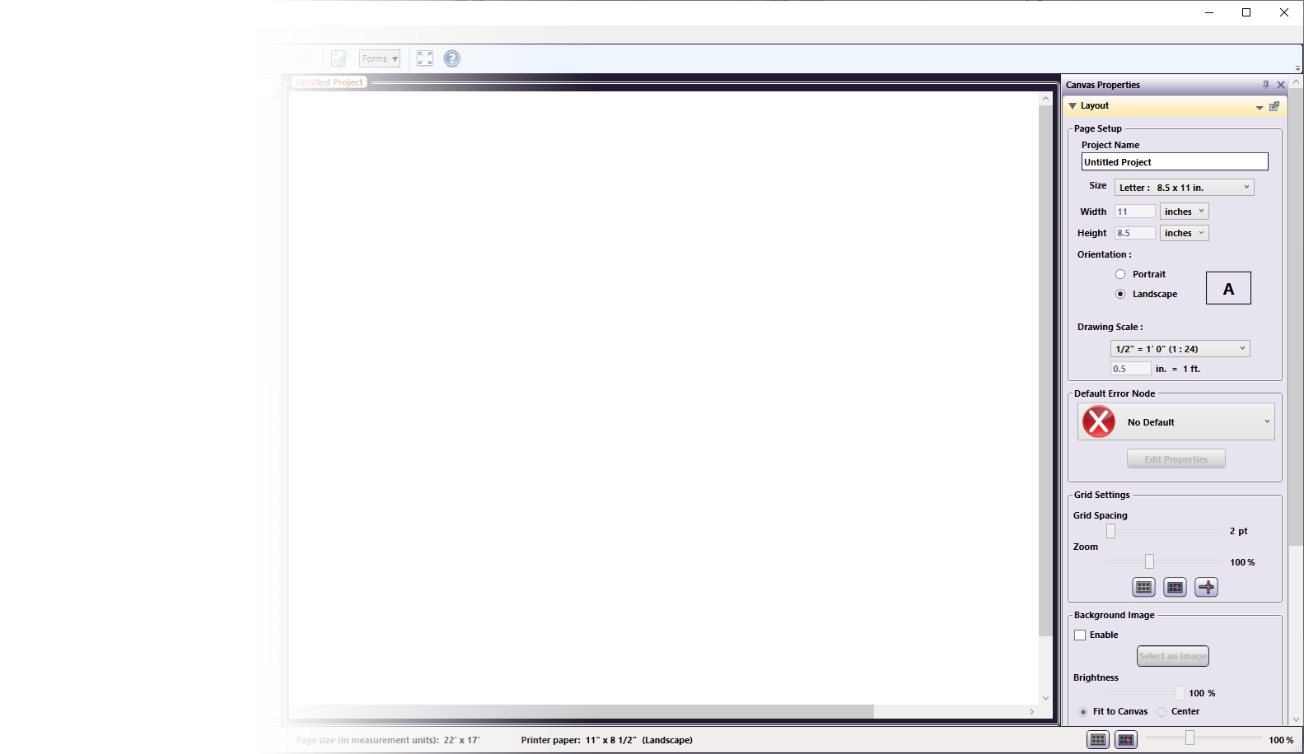








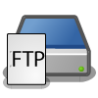


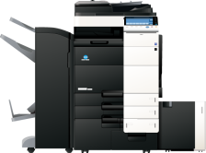





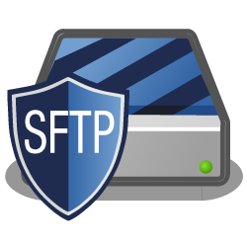

Store Documents In A Single Step
Customize your workflow to send processed documents to a variety of outputs in a single step! Distribution options include:
Folder on the network or Desktop
FTP Server
SFTP Server
Email
Printer
Windows Fax
Production Print Systems
Guardian by LawLogix
OnBase by Hyland
Workshare
Laserfiche
And More…

Slide 11

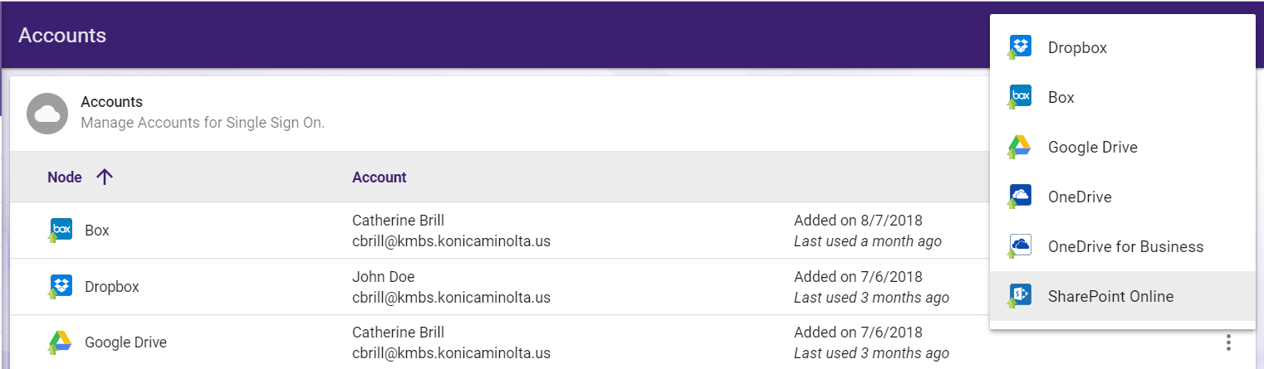
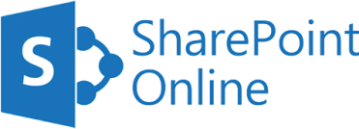

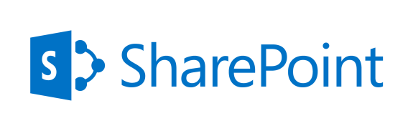





Sharing Documents to Drive Collaboration
Send processed documents to major cloud storage systems
Easy-to-use cloud connectors provide single sign-on to the cloud

Slide 12

Powerful Scalability
With Dispatcher Phoenix’s enhanced scalability, you can create unique, modular, cost-effective solutions tailored to changing business needs. Optional add-in modules include:
  Forms Processing
  2D Barcode Processing
  Copy Defender
  Release2Me for secure print release
  Specialized connectors
  Much more…

Slide 13


Education-Specific
Use Cases

Slide 14

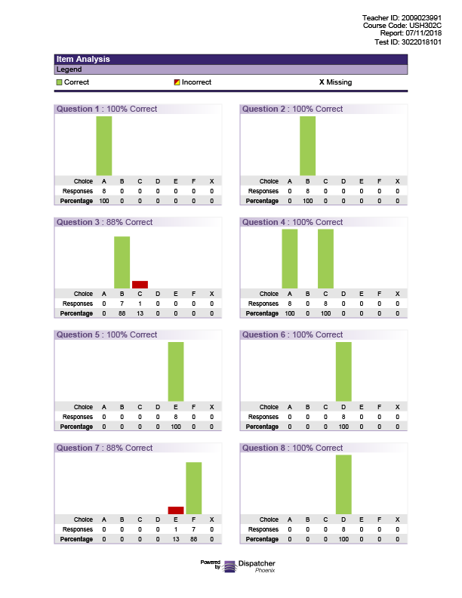

Grade Bubble Sheet Tests Automatically
Teachers spend too much time and effort grading tests manually.
  Manual grading increases the chance of grading errors.
  Schools, colleges, and universities spend too much money on preprinted forms or slow scanning systems that are expensive to maintain.
Dispatcher Phoenix’s Bubble Grader solution automatically grades tests and generates
analytical reports about classroom
performance.
  Includes web-based bubble sheet
  designer which allows schools to
  create/print custom bubble sheets on plain paper! Huge cost-saver!

Slide 15

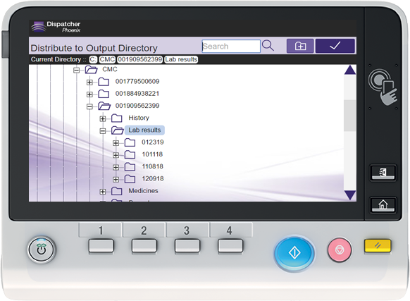
Scan, Index, and Distribute Educational Records
Browse through a Windows Explorer-like view of PC folder structure to find teacher’s folder – directly at the MFP.
Send processed student records, exams, curriculum resources, etc. to document management systems (e.g, SharePoint, Box, Google, Dropbox).
Index acceptance letters and other documents at the MFP or via web interface.

Slide 16
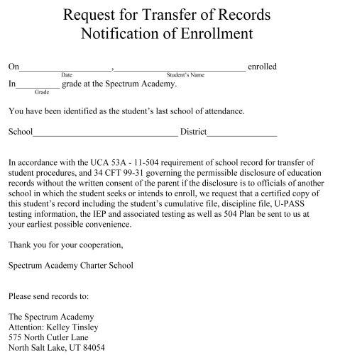

Safeguard Student Records
Find and redact sensitive student information automatically.
  Redaction terms can be entered/modified directly at the MFP.
Convert transcripts into password-protected PDFs.
Secure printing with Release2Me, Dispatcher Phoenix’s secure print release system with web-based reporting and print delegation features.

Slide 17
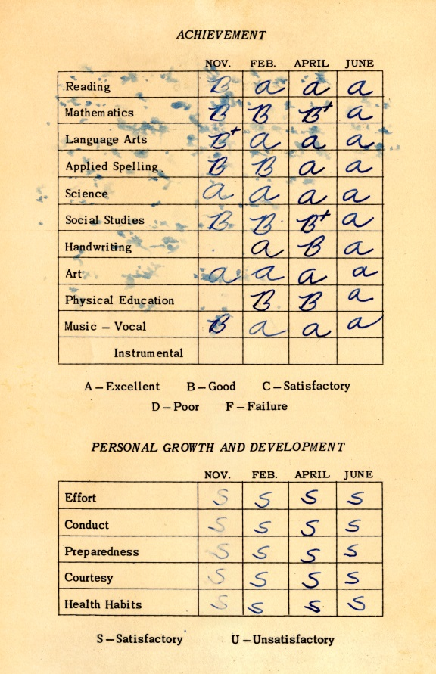
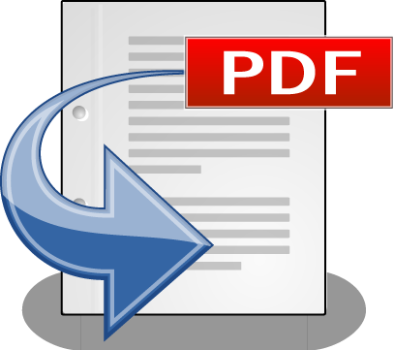
Manage Paperwork for Students and Faculty
Automatically convert student records to a variety of PDF and Microsoft Office formats.
Supported PDF formats include PDF Searchable for keyword searching and PDF/A for long-term archiving.
Supported Microsoft Office formats include Microsoft Word, Excel, PowerPoint, and much more to edit scanned files.

Slide 18
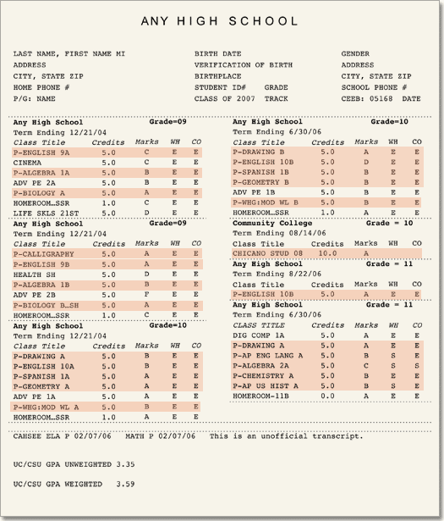

Automatically Extract Transcript Data
No more manually keying in student data to third party systems!
A Dispatcher Phoenix automated workflow can extract key information from student transcripts using zonal OCR for use in other applications.
This extracted data can also be used to process documents (e.g., rename files, organize files, route files, annotate files, etc.).

Slide 19
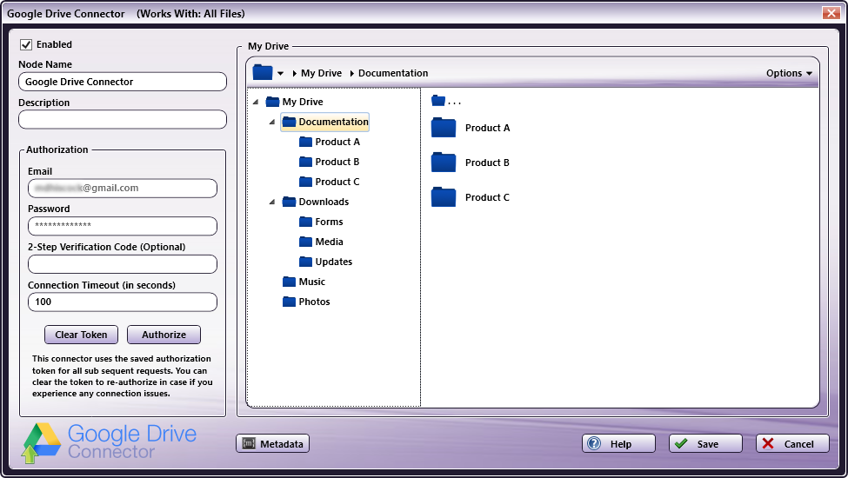
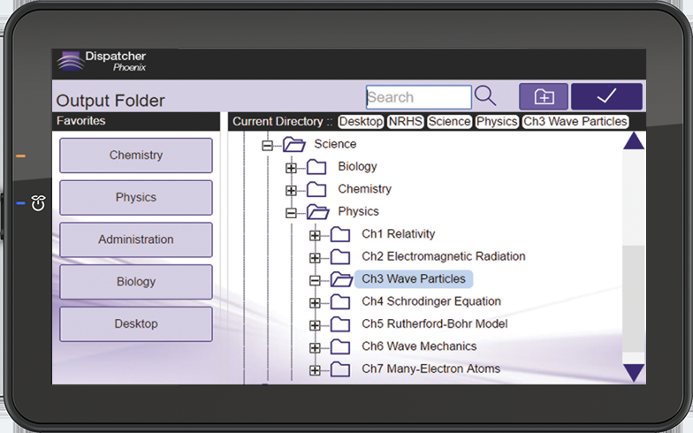

Send Processed Student Records Directly to Google Drive
Today’s educational organizations need to make sure that class and student information can be shared and accessed immediately.
For those high schools or colleges that use Google Drive to manage their education documents, Dispatcher Phoenix offers a direct connector to Google Drive.
Administrative staff and teachers can easily scan to their favorite Google Drive folder – right from the MFP.
Single sign-on convenience optimizes the user experience!

Slide 20

With Dispatcher Phoenix Educators Can:
Handle their workload efficiently, so more time is spent in the classroom.
Protect student information via intelligent redaction.
Convert files to PDF/Office for text searching and editing.
Streamline grading with automated test grading and reporting.
Save money by printing bubble sheet tests on plain paper.
Index and store documents easily for future retrieval.
Access workflows from anywhere by using the mobile app.
Securely print of student records, teacher evaluations, application forms, etc.
Scan documents to popular academic connectors, such as Google Drive, OneDrive, Box, Dropbox, etc.
Benefits:
The student experience is improved.
Seamless communication between departments.
Time & money is saved.
Document processing errors are eliminated.
Educators have more time to teach.
Creates a positive and efficient work environment.

Slide 21
Resources

Slide 22



Marketing Collateral
Dispatcher Phoenix
Brochures
Education.
Bubble Grader.
Battlecards.

Slide 23

Additional Resources
Demo Licenses
Fully-functional 30-day demo licenses.
Sample Workflows
Fully-configured sample workflows include templates for Education features.
NFR Licenses
Fully-functional licenses to help you demo or test workflows.
MFP Simulator
Show your customers how easy it is to use Dispatcher Phoenix with our Flash-based MFP Simulator…now available with bizhub, i-Series, and production print panel displays!

Slide 24


Thank You
sec@kmbs.konicaminolta.us

